Slide 1


BANK TELEMARKETING EXPLORATORY DATA ANALYSIS (EDA) USING PYTHON

Slide 2
The bank wants to make more money by running a smart and cost-effective sales campaign to convince its current customers to invest in term deposits. Term deposits are like savings accounts where you lock in your money for a certain period at a fixed interest rate. The goal is to build stronger relationships with customers over time.
To achieve this, they will analyze a bunch of data from the campaign to see what works best. They'll look at things like who their customers are (like age, where they live, etc.), when is the best time to contact them, and other factors that might influence whether they say yes to the investment offer. By doing this detailed analysis, they hope to figure out what strategies are most effective and how they can improve their sales pitch to get more people to say yes.
So basically, they want to be smarter about how they sell term deposits to their customers to make more money and keep their customers happy.

Slide 3
EXPLORATORY DATA ANALYSIS
Understanding the Dataset
2. Descriptive Statistics
3. Univariate Analysis
4. Bivariate Analysis
5. Categorical Variables Analysis
6. Temporal Analysis
7. Feature Engineering
8. Correlation Analysis
9. Outlier Detection and Handling

Slide 4
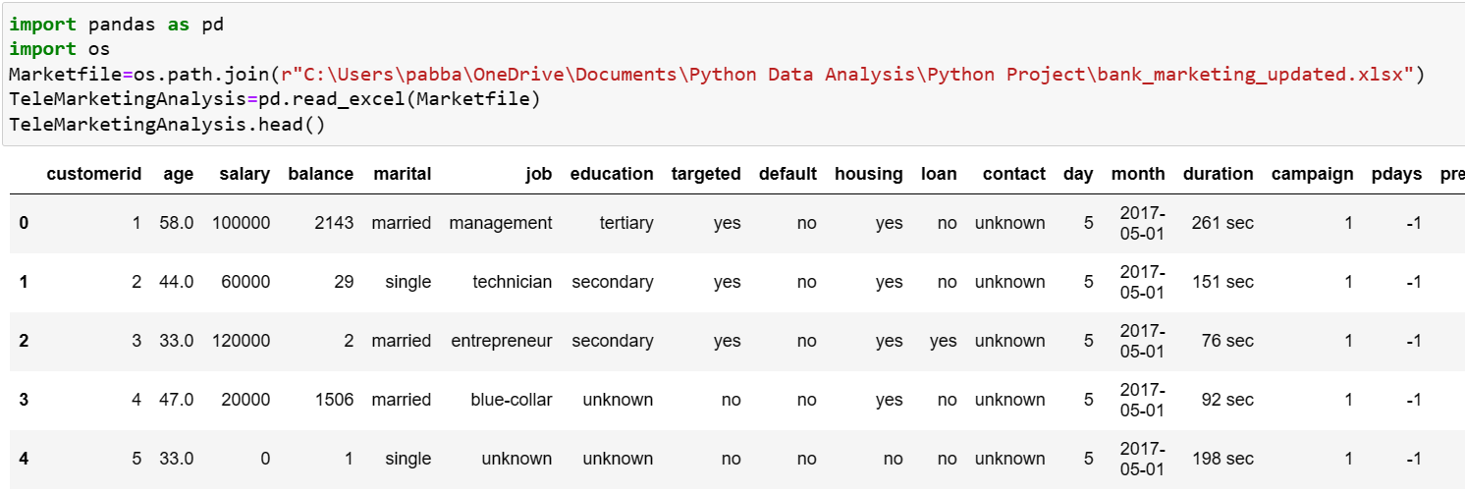
UNDERSTANDING THE DATA

Slide 5
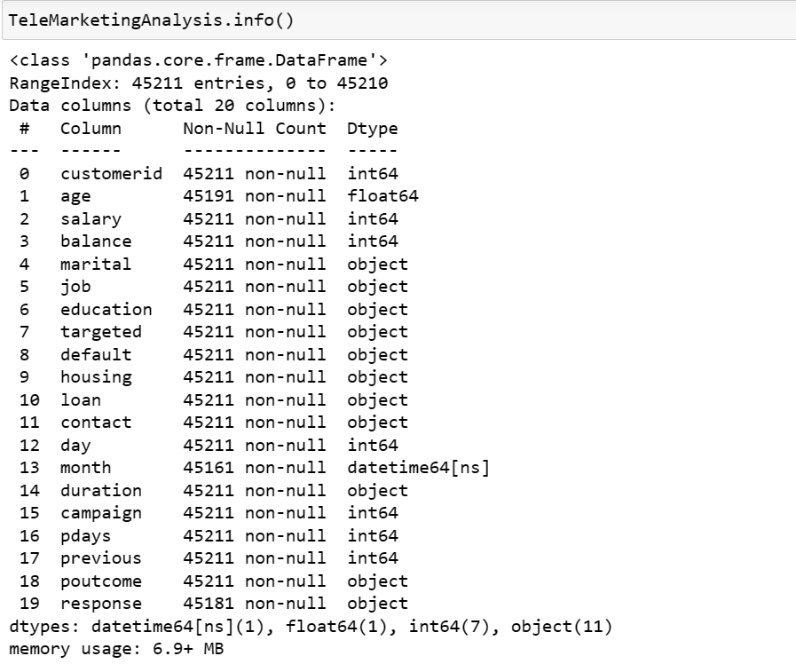

Slide 6
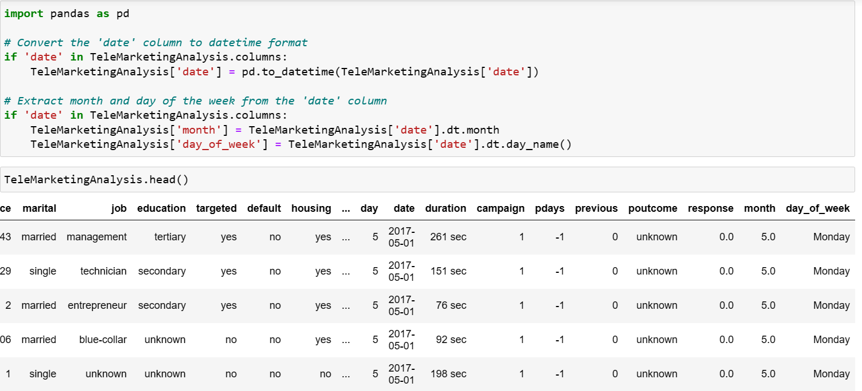

Slide 7
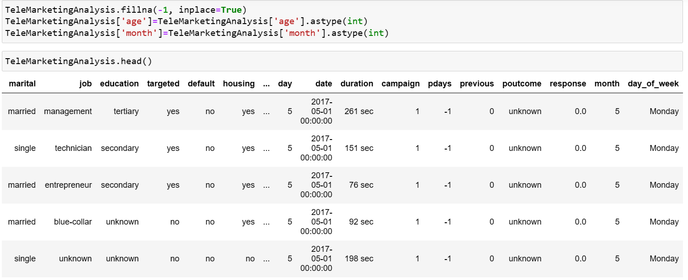

Slide 8
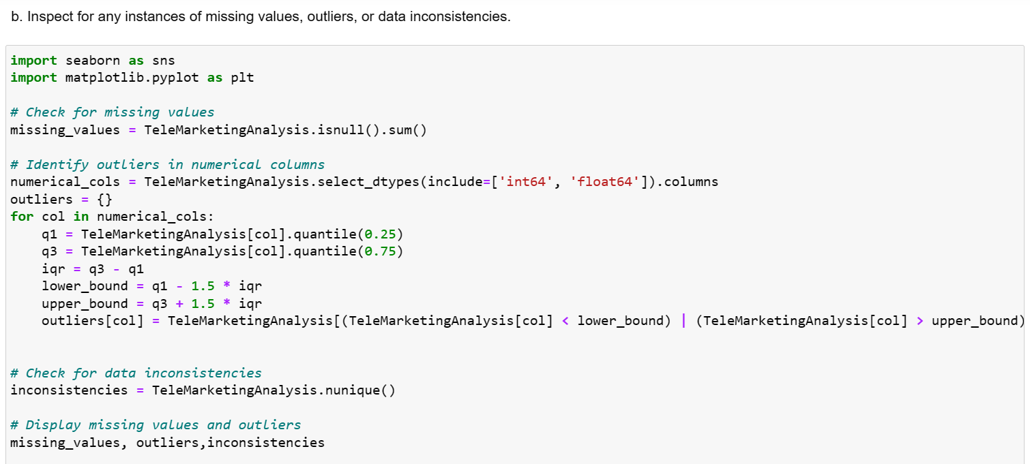

Slide 9
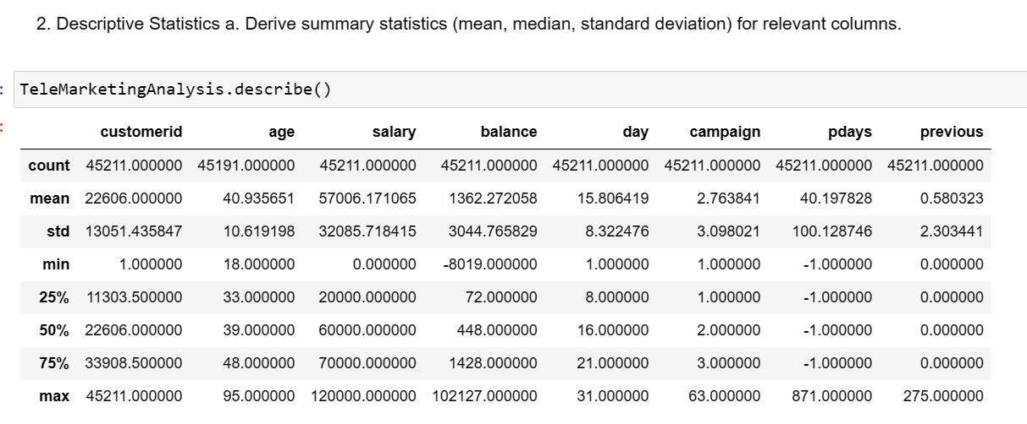
DESCRIPTIVE STATISTICS

Slide 10
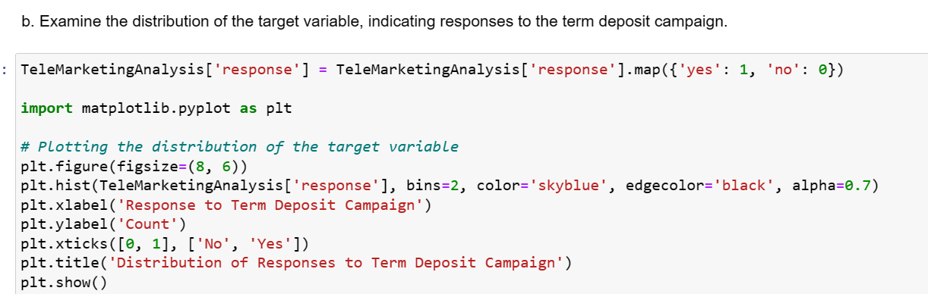

Slide 11
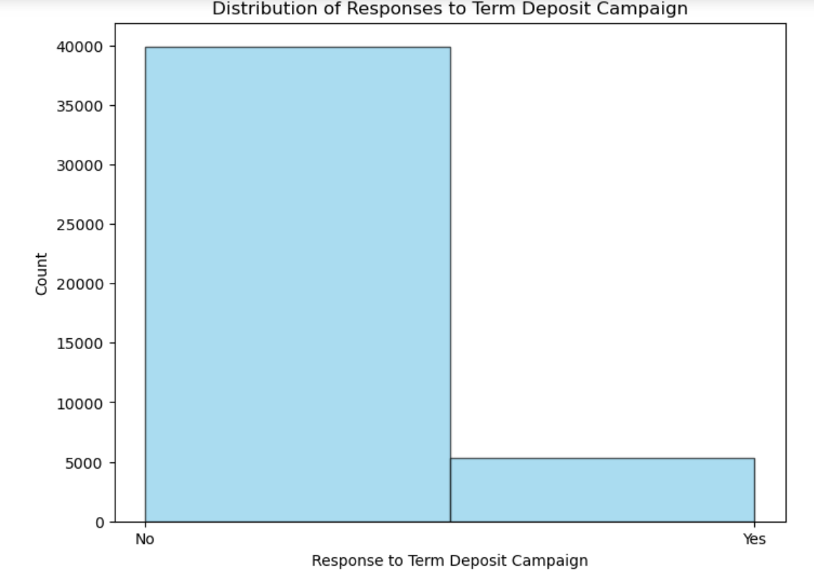

Slide 12
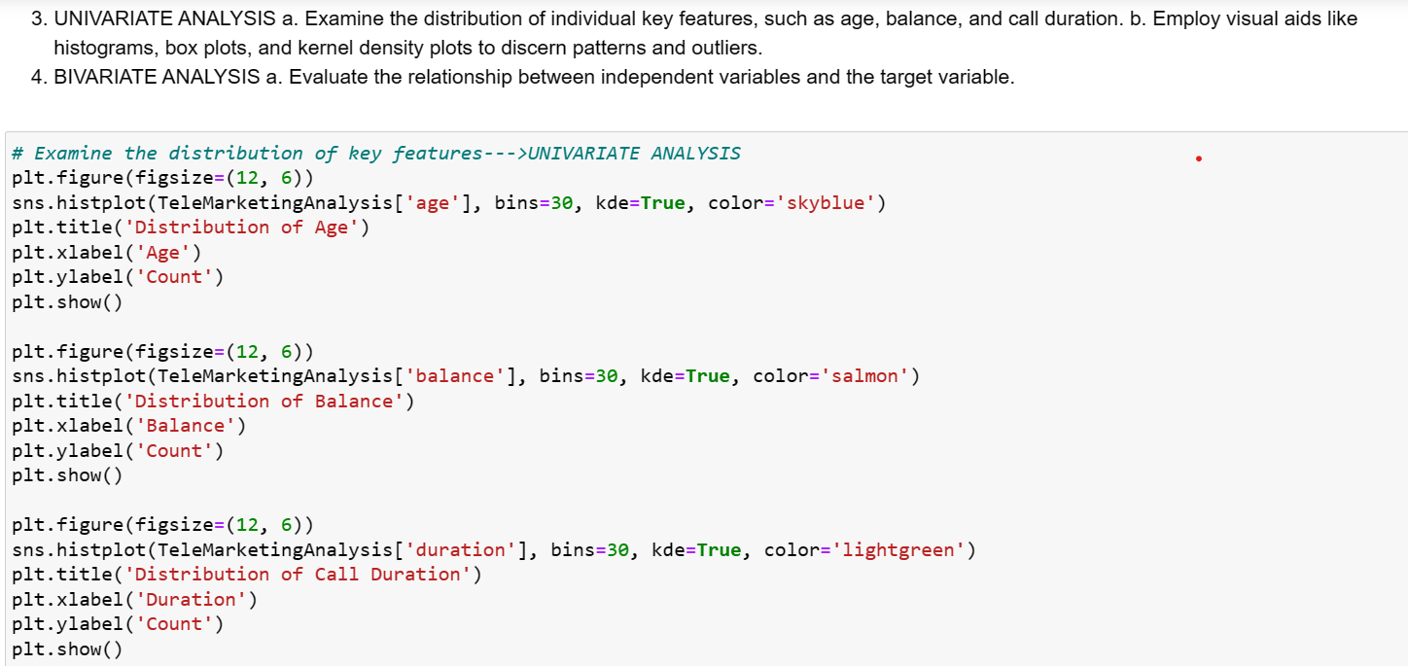
UNIVARIATE ANALYSIS

Slide 13
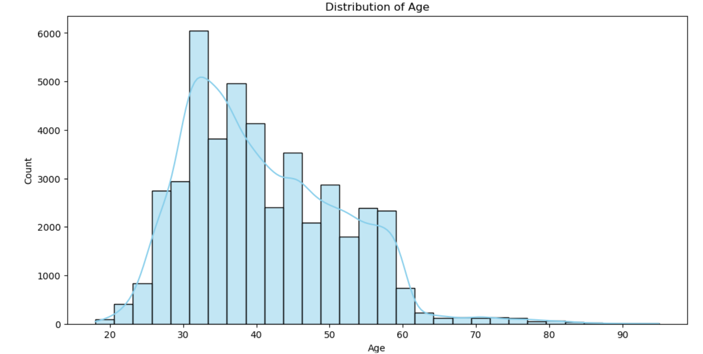

Slide 14
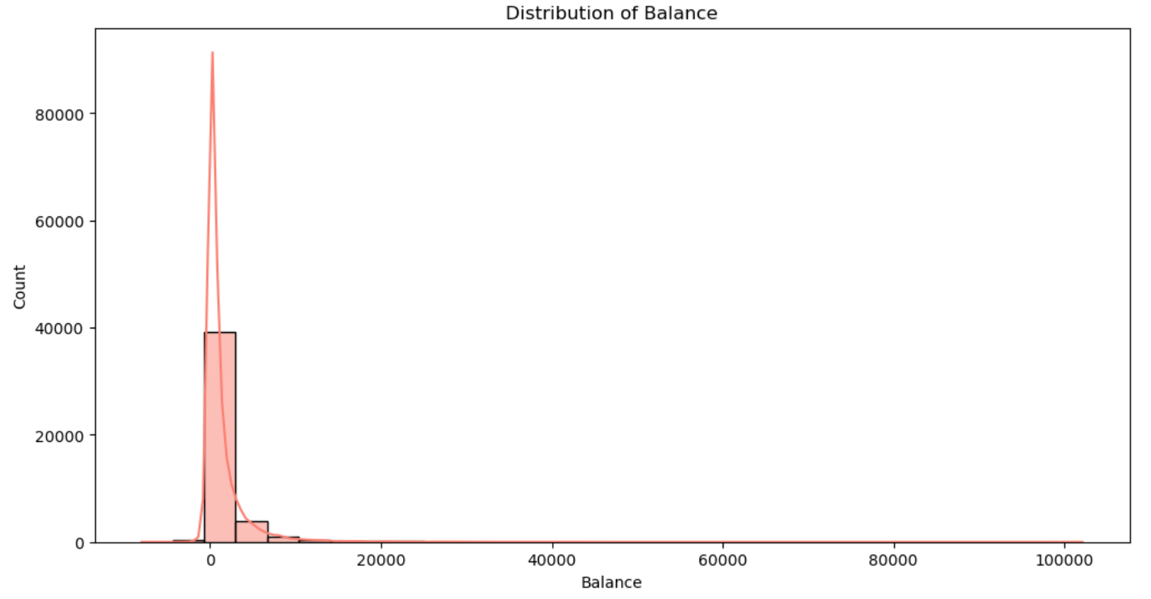

Slide 15
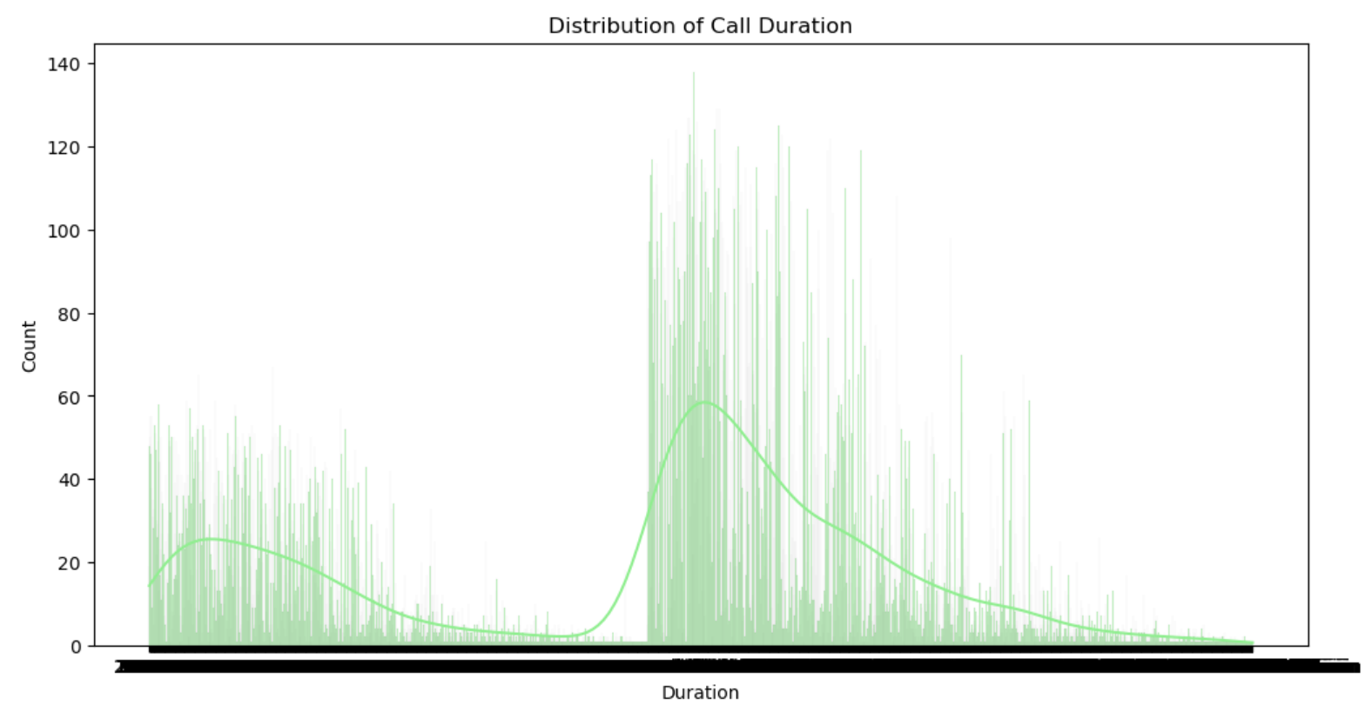

Slide 16
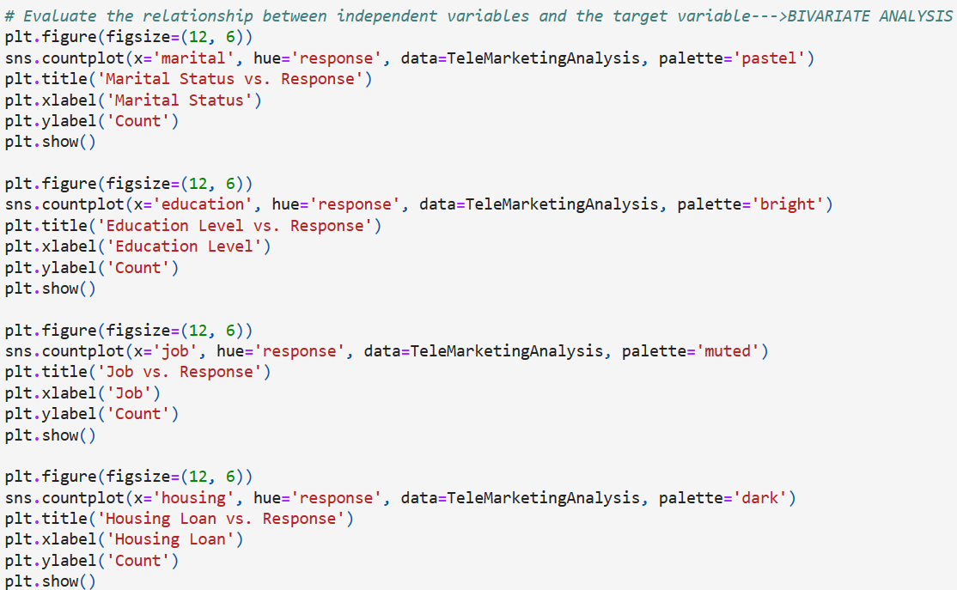
BIVARIATE ANALYSIS

Slide 17
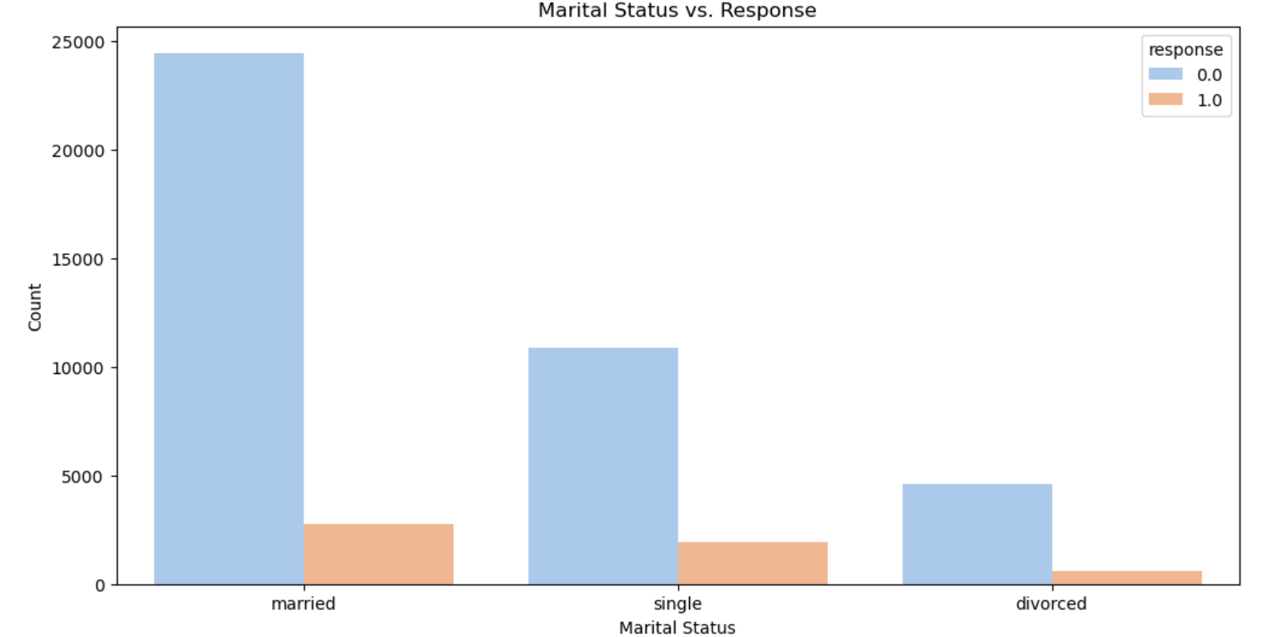

Slide 18
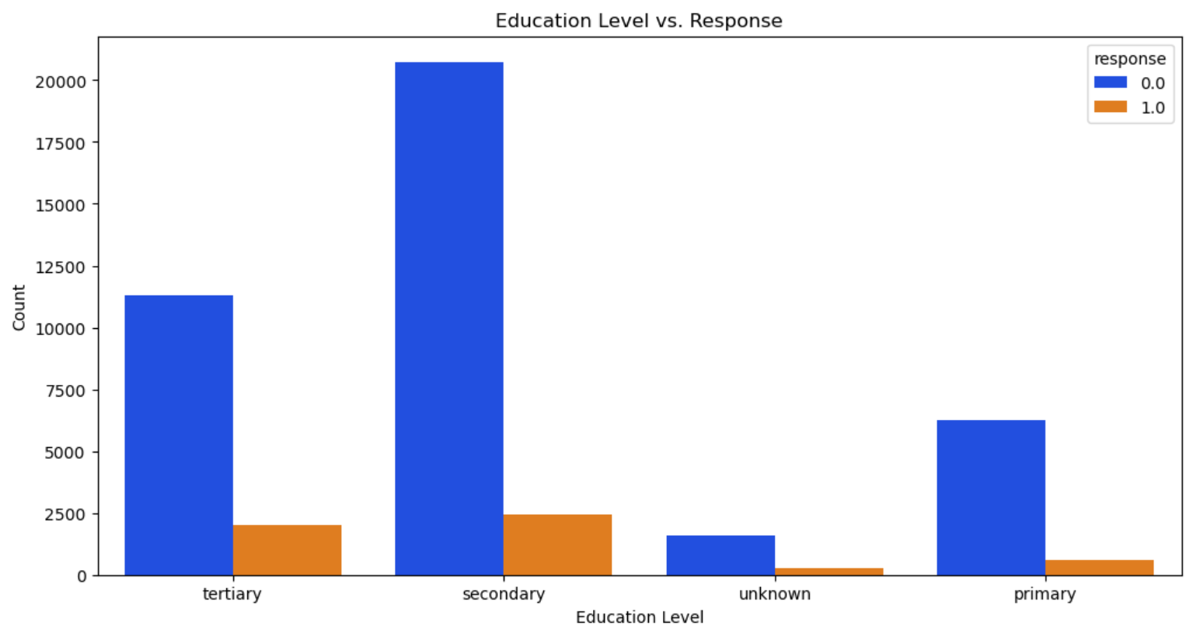

Slide 19
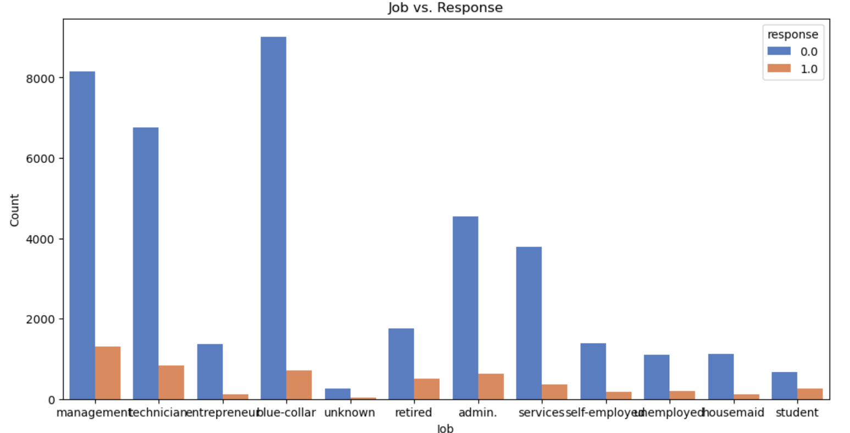

Slide 20
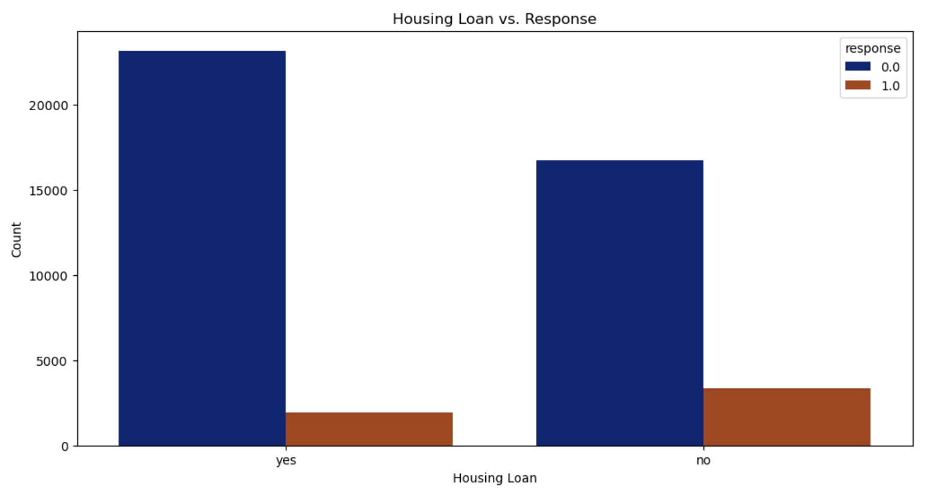

Slide 21
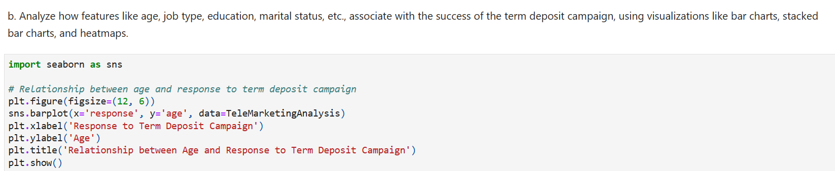

Slide 22
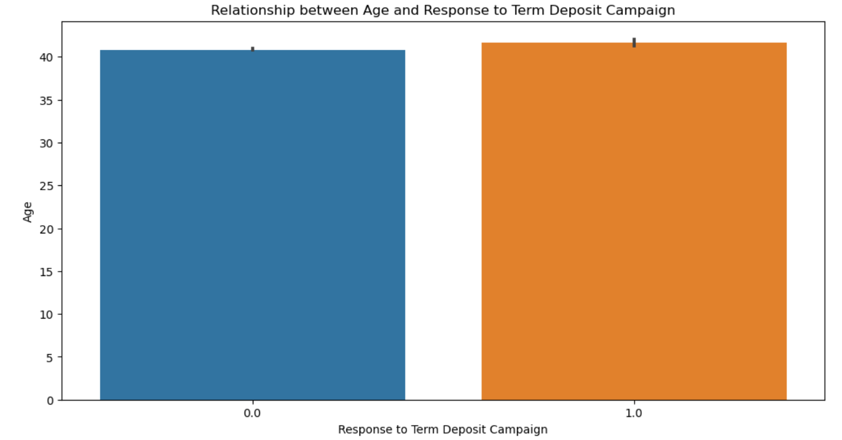

Slide 23
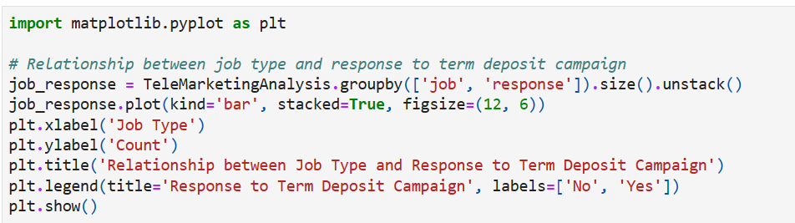

Slide 24
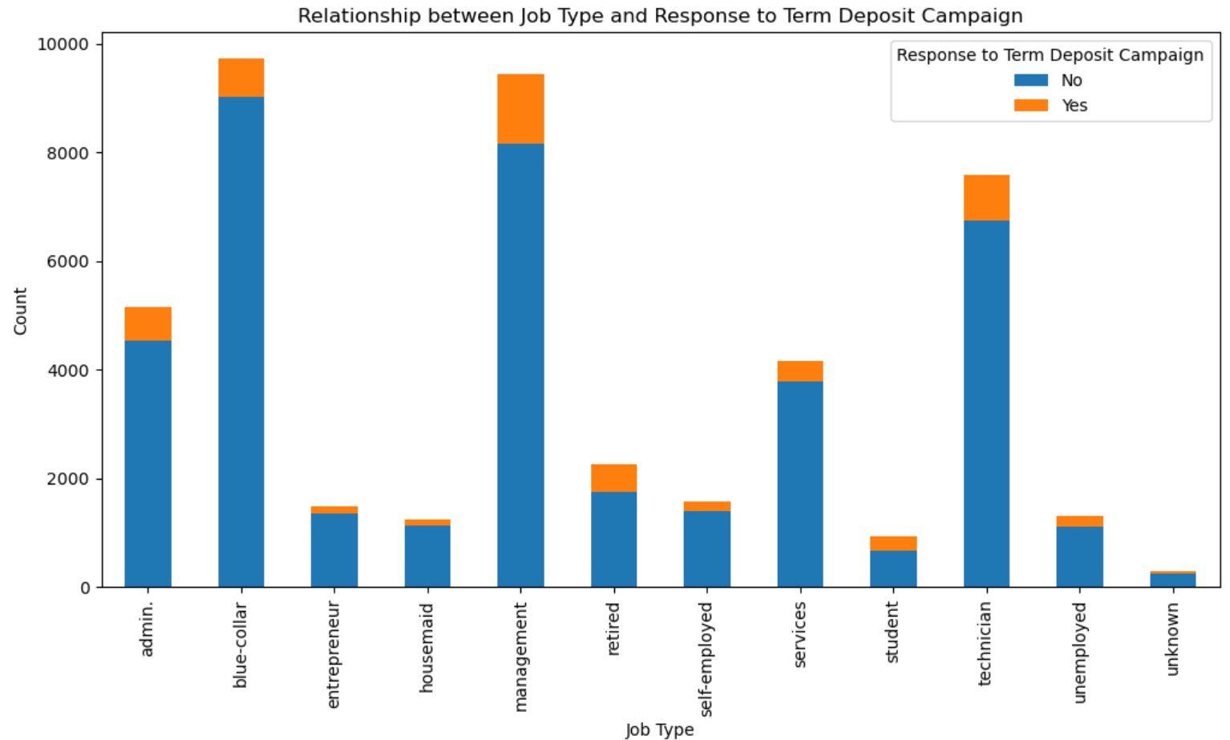

Slide 25
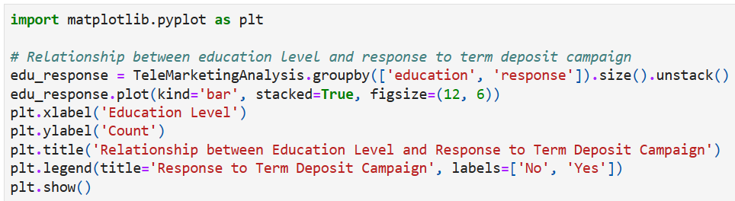

Slide 26
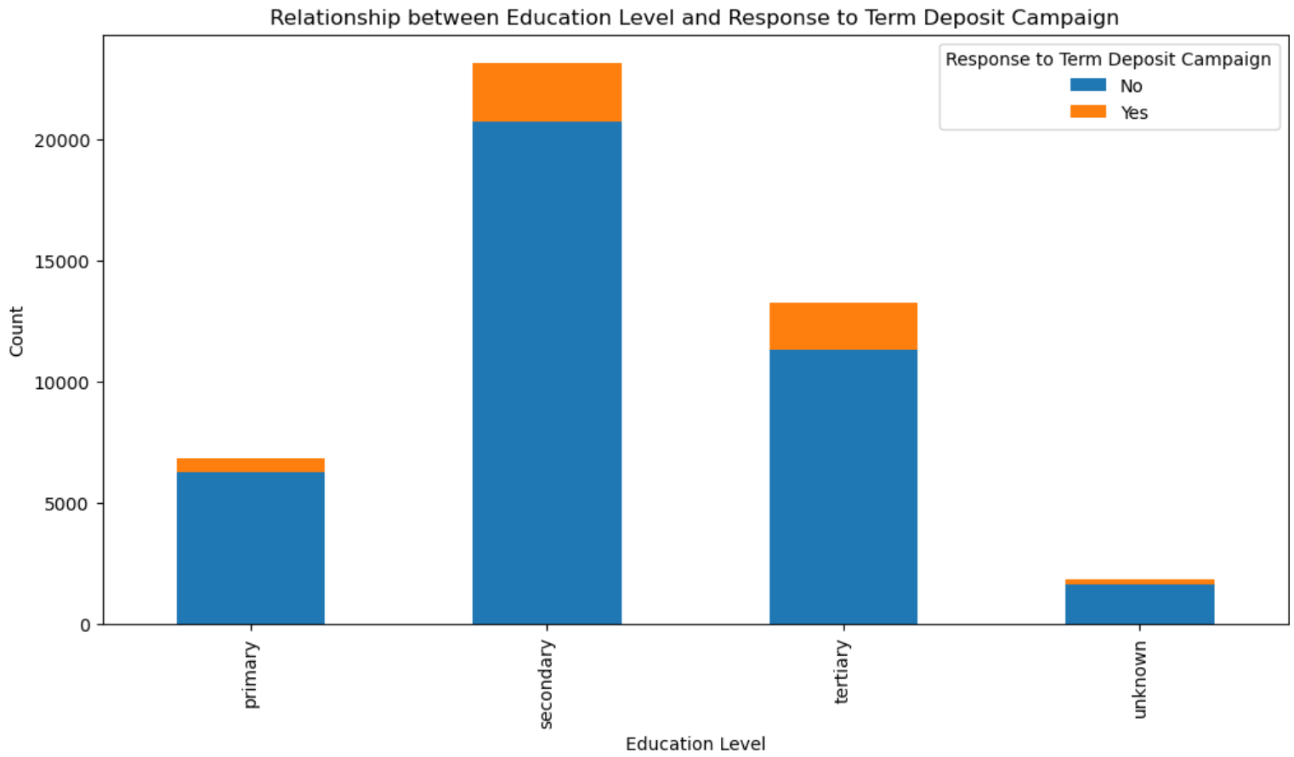

Slide 27
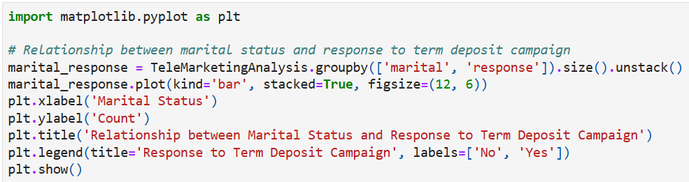

Slide 28
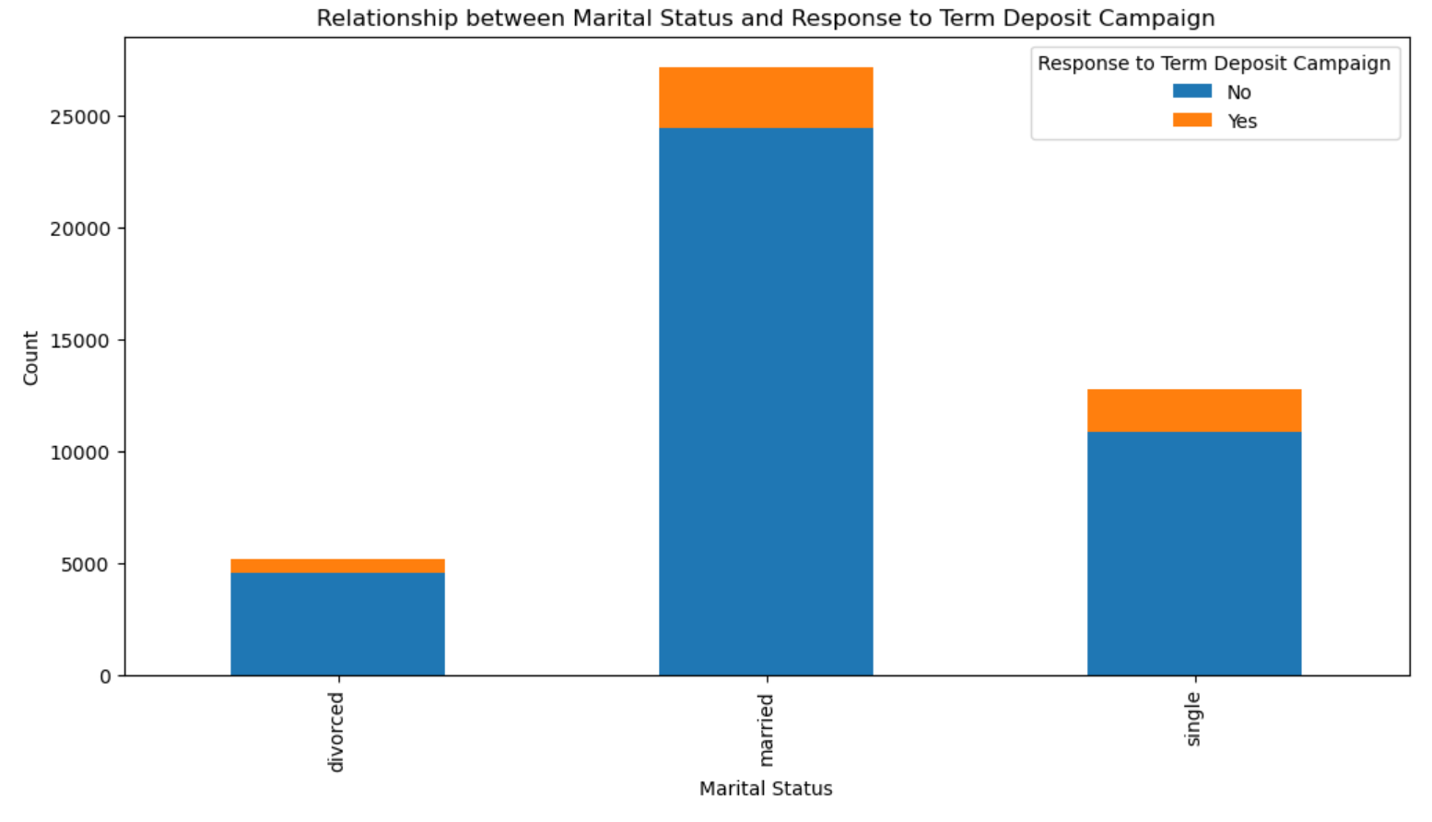

Slide 29
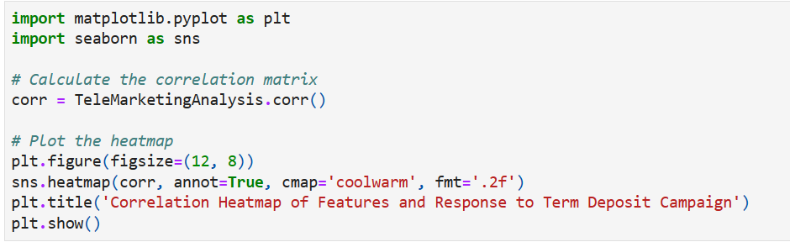

Slide 30
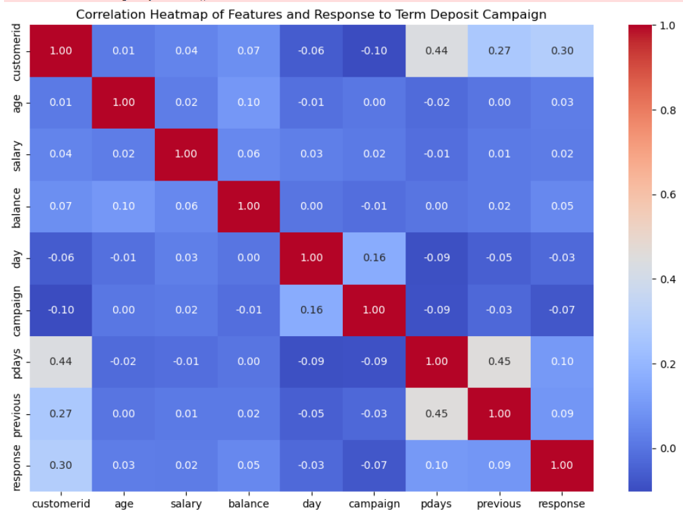

Slide 31
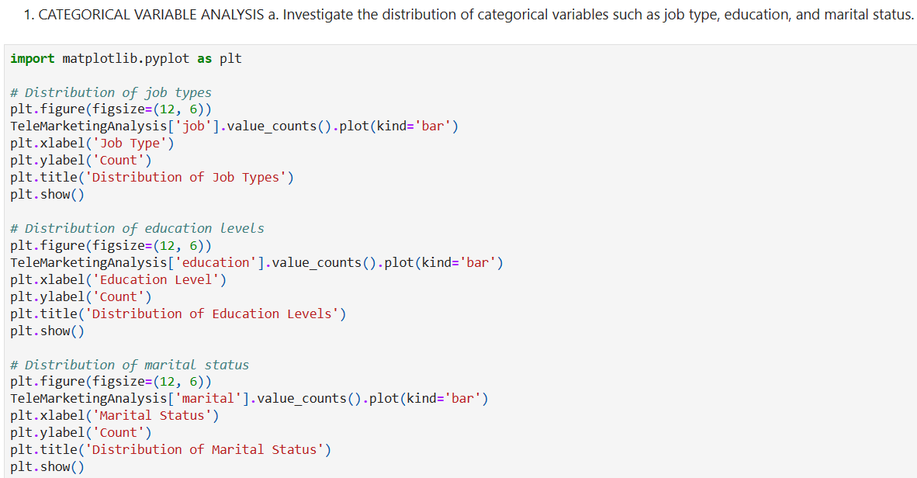
CATEGORICAL VARIABLE ANALYSIS

Slide 32
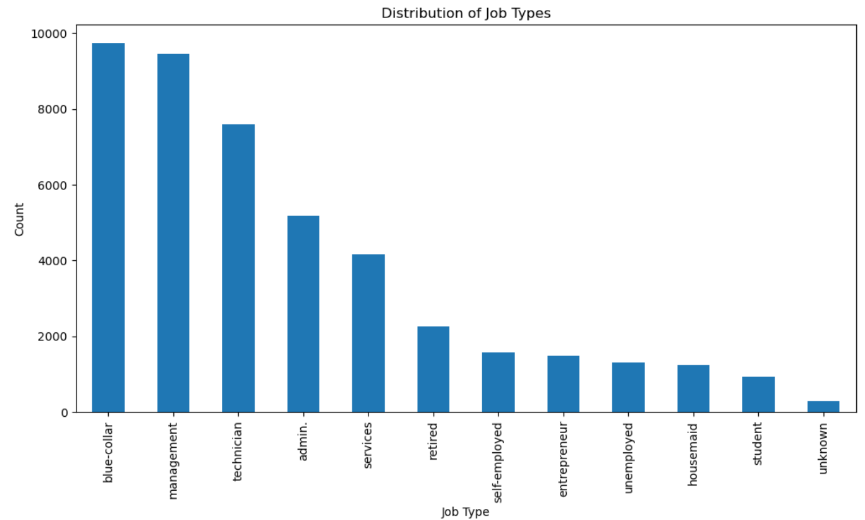

Slide 33
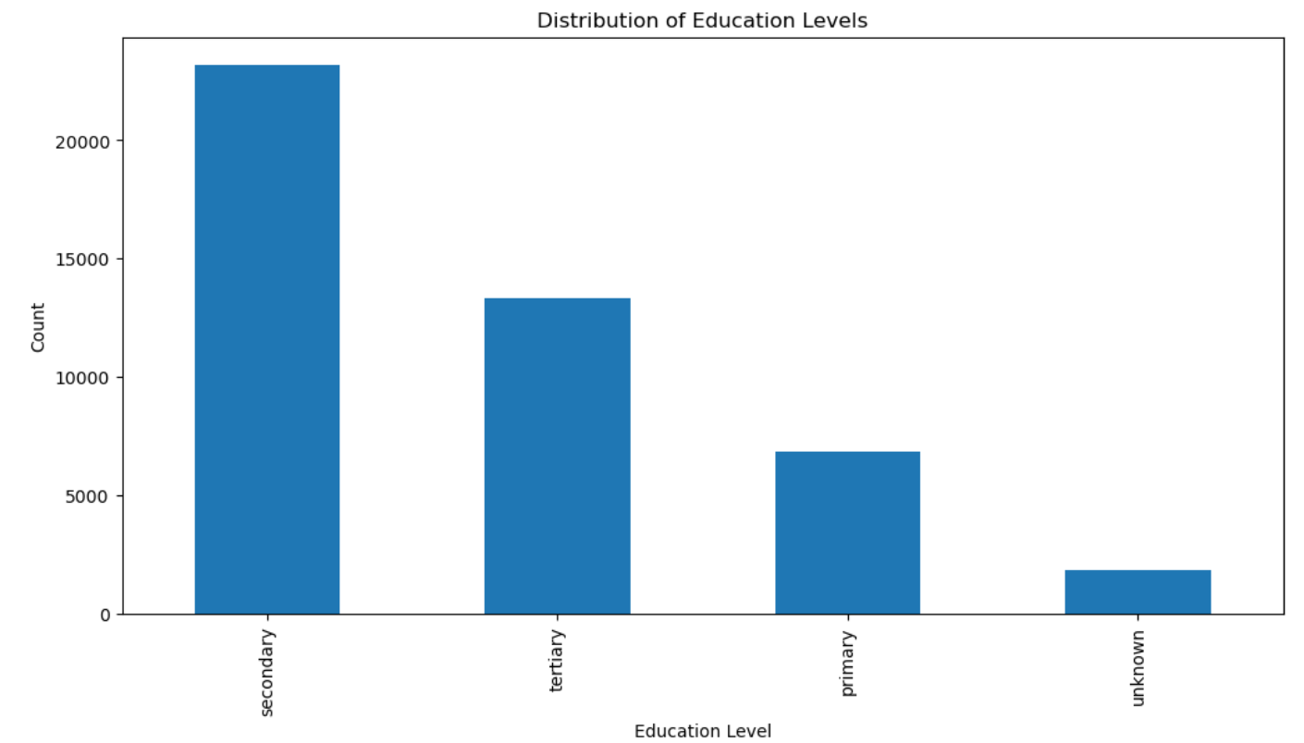

Slide 34
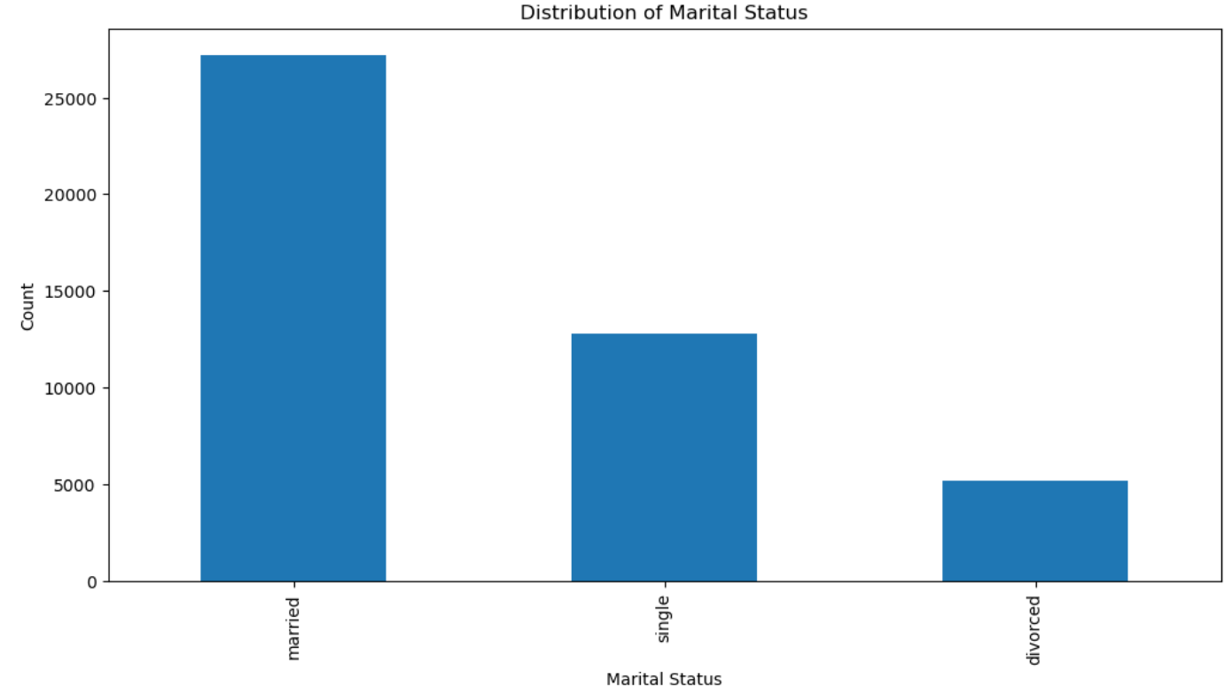

Slide 35
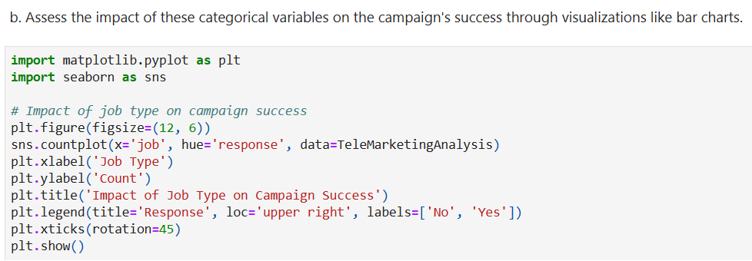

Slide 36
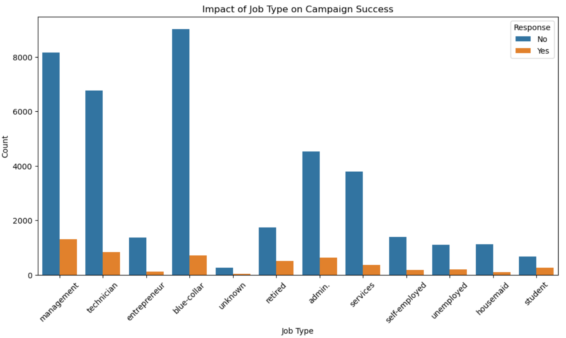

Slide 37
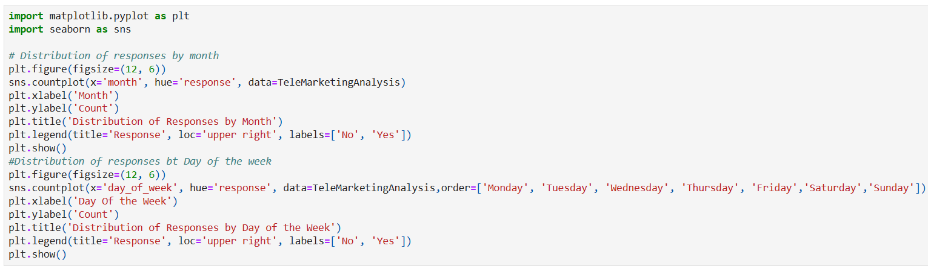
TEMPORAL ANALYSIS

Slide 38
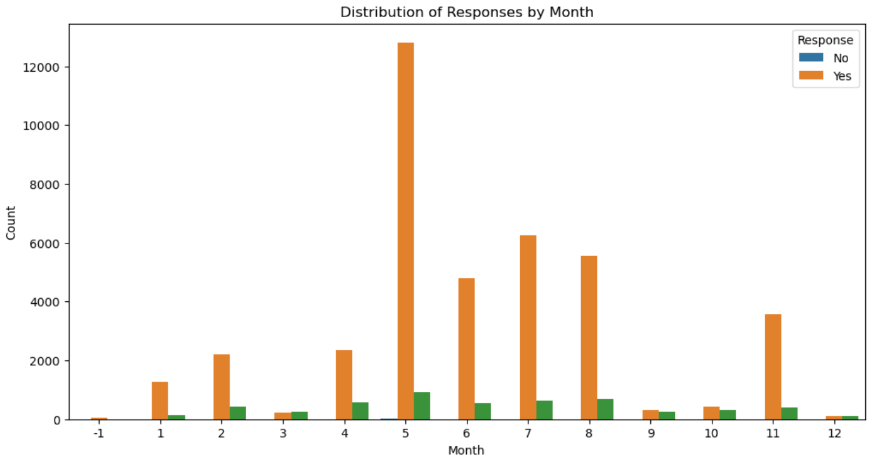

Slide 39
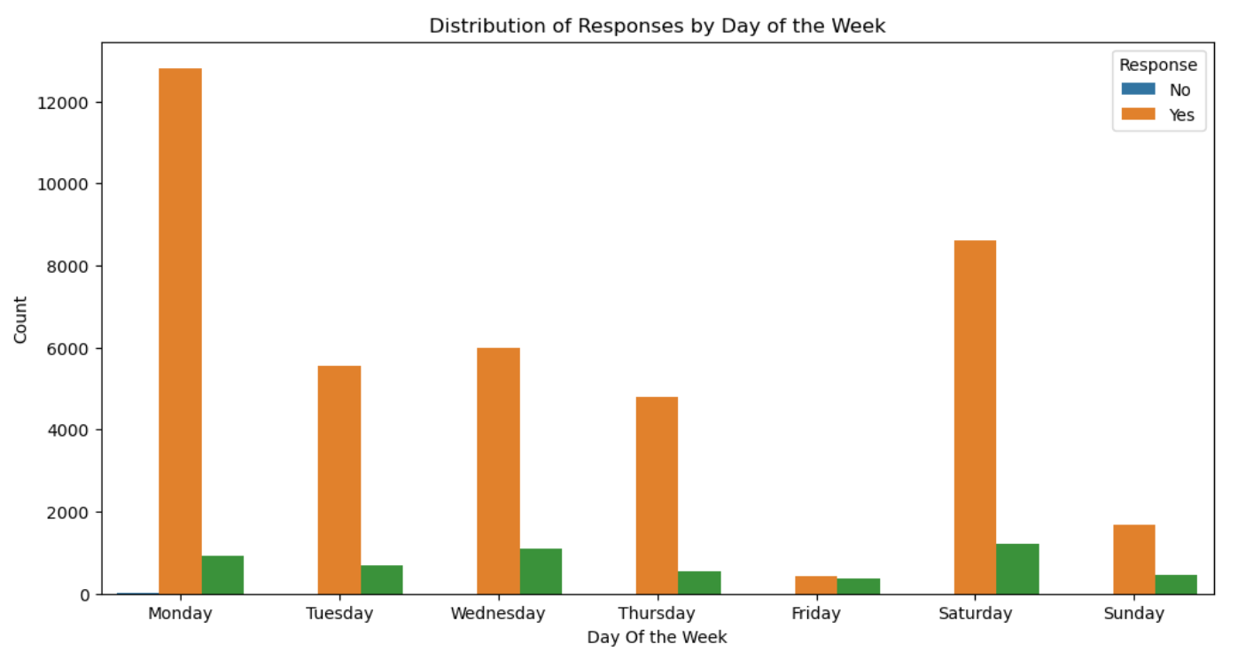

Slide 40
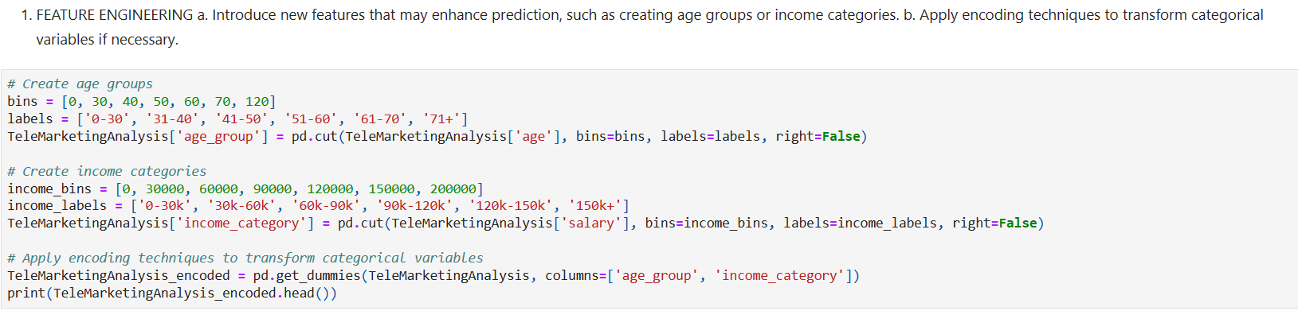
FEATURE ENGINEERING

Slide 41
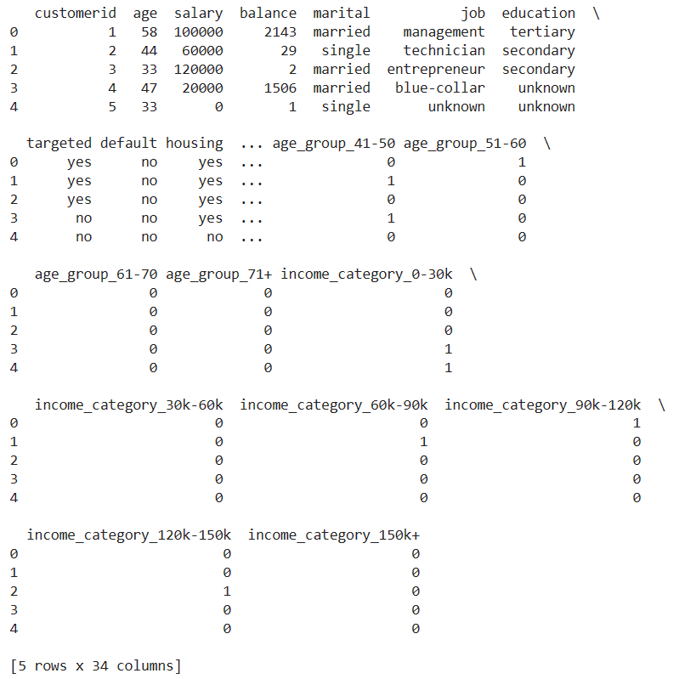

Slide 42
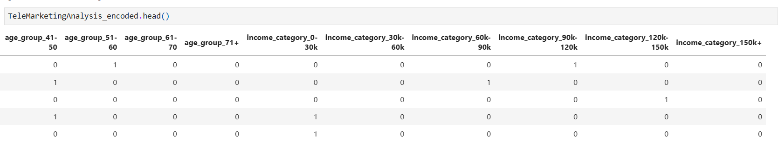

Slide 43
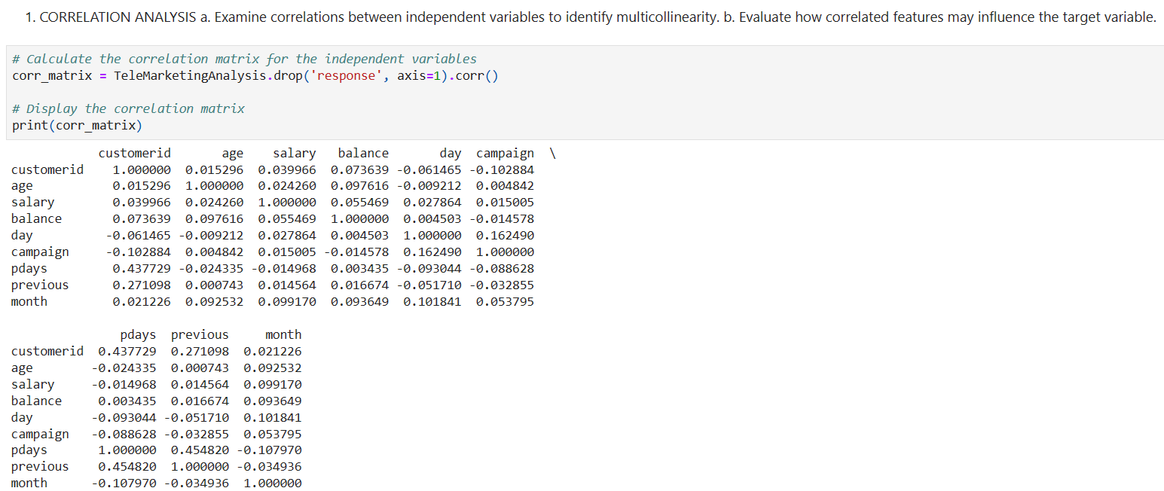
CORRELATION ANALYSIS

Slide 44
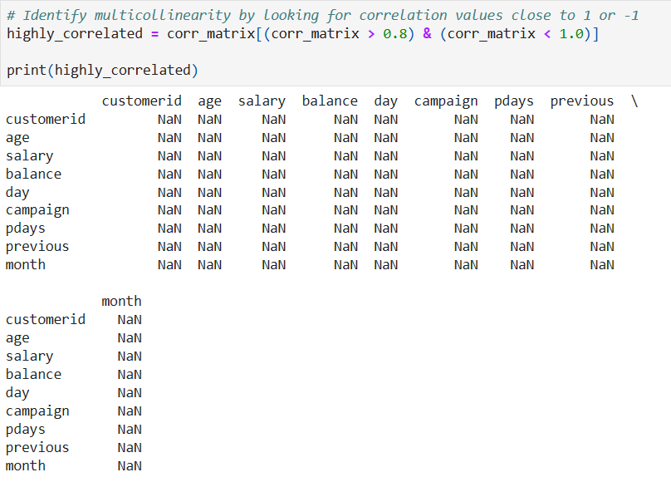

Slide 45
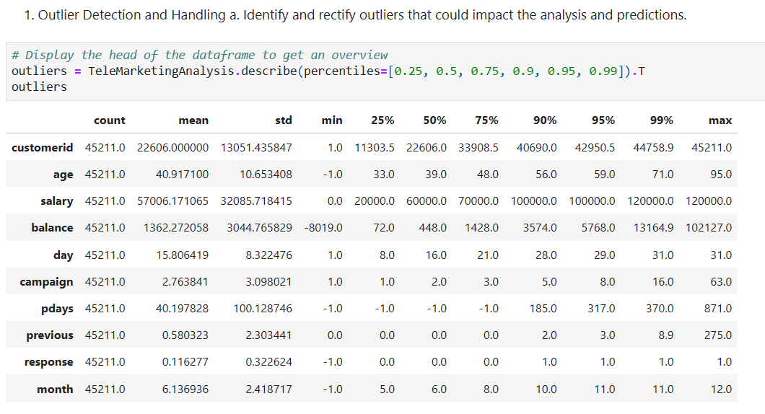
OUTLIER DETECTION AND HANDLING

Slide 46

THANK YOU
NAVEEN KUMAR P

